Slide 1
References Review
CS 201, Summer 2013

Slide 2
ADDITIONAL READING
References
  Chapter 8 Pearson Book
  http://www.learncpp.com/cpp-tutorial/611-references/

Slide 3
What are References again?
Use the ampersand (&) sign
Deals with memory addresses in C++
One way to pass arguments as by-reference
  We can also pass by-reference with Pointers
Variables still look simple, behave the same, but now the variable is a “reference” to another variable.

Slide 4
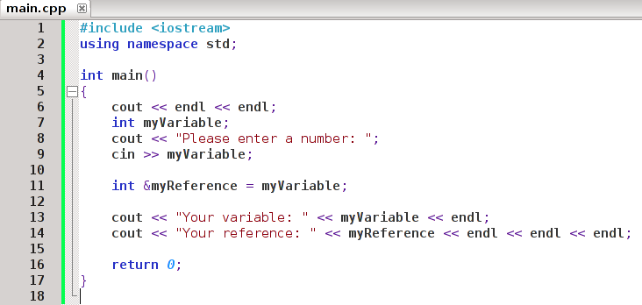
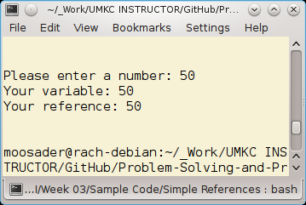
Simple References
Just declare with a & prefix
Use a reference-variable just like a normal variable
Sample code under “Week 03” folder on class webpage

Slide 5
Reference & Address-Of
The meaning of “&” can change based on the context.
When you're declaring a variable with &, it is a reference-variable.
When you're using the & on a variable, & is a address-of operator.
Remember that operators are symbols like
+, -, *, &, ::, <<, etc.

Slide 6
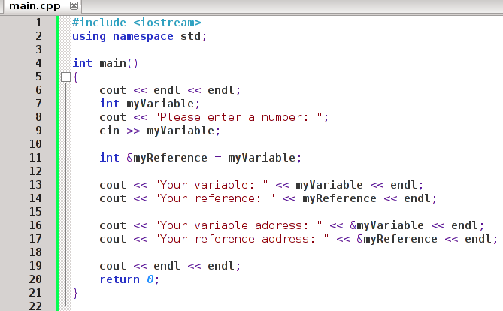
Reference & Address-Of
Outputting variable values
Outputting variable addresses

Slide 7
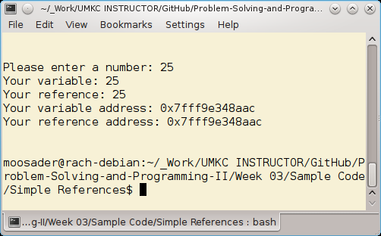
Reference & Address-Of
Address-of operator works for Regular Variables and Reference Variables

Slide 8
References & Functions
C++ functions can only return one value.
We can use References to return more-than-one through the parameter list.
Everything works the same, except in the parameter list you have ampersands before the variable name.

Slide 9
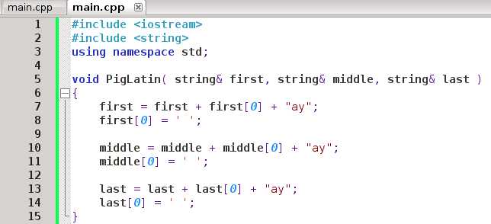
References & Functions
Nothing returned, just modified within the function.

Slide 10
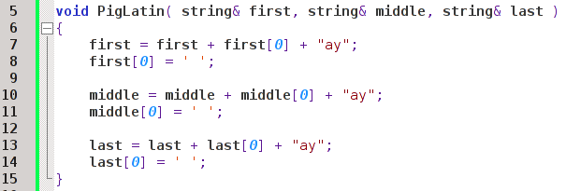
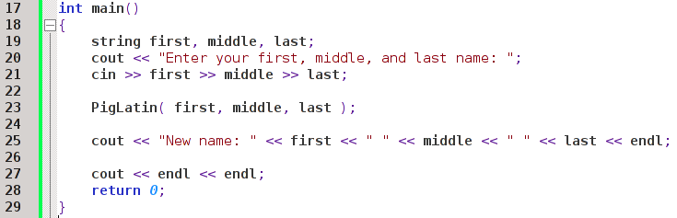
References & Functions
Get variable data
Pass by-reference
New variable data!

Slide 11
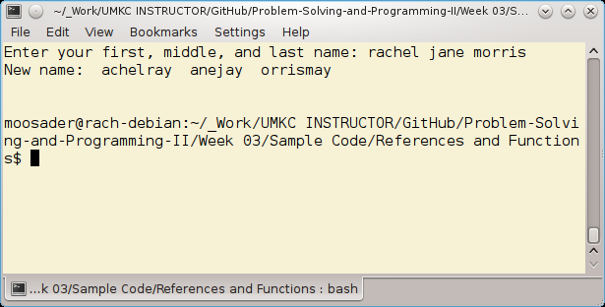
References & Functions
And now we can easily
localize our software
In Pig-Latin!!

Slide 12
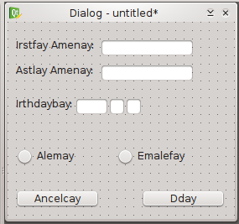
Pig-Latin should be the universal second language
(I am kidding)

Slide 13
const – again!
And, to mention again, even though we can get multiple “return values” through the parameter list:
We might not always want the variable data to change, even though we pass it by-reference:

Slide 14
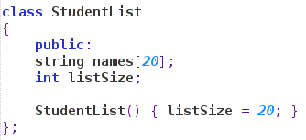
const
Our class contains an array of 20 names and the size of the array (initialized to 20).
If this class array were huge, this would take a long time to copy over when passing it as a parameter.

Slide 15
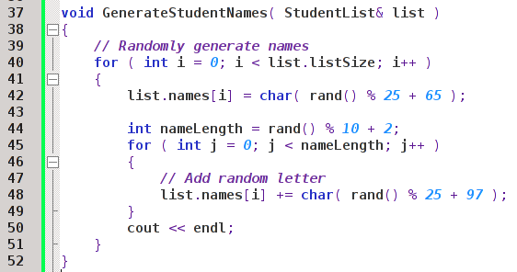
const
Generates random letters to make weird looking names
We have a function where we want the values within the StudentList object to change – it's responsible for generating the data!

Slide 16
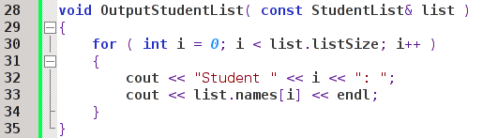
const
With a function that outputs that data – it shouldn't need to change anything!
Pass in the StudentList& reference as a const, so we ensure nothing will change!

Slide 17
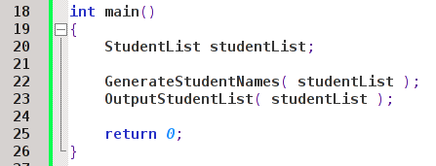
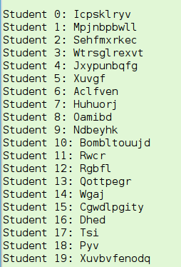
const
Passed by reference
Passed by const reference
Our randomly-generated student names

Slide 18
One last referencey thing
When we declare a reference-variable in C++, that reference-variable must be immediately initialized!
If you don't give a reference-variable a value during declaration, you will get a compiler error.
A reference-variable can only ever hold a reference to one variable. It cannot change referenced variables later.

Slide 19
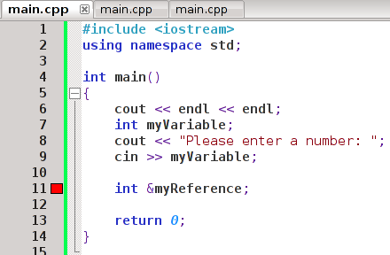
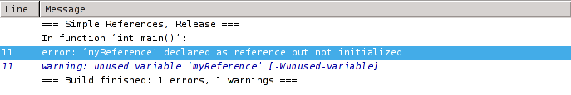
One last referencey thing

